Slide 1
Presentation 8
Vivek K
PhD project

Slide 2
How did we choose the technical markers?
To recap, the technical markers are those that are present during all movement trials as well as during the static calibration
The minimum number of markers required to construct a frame are N = 3. For simplicity, N = 3 was chosen as the number of technical markers required
The marker set common to all trials was determined from the data for each subject and body segment
Anatomical: If a set of exactly three anatomical markers corresponding to a given body segment was present, they were considered (reduced soft tissue artifact, easier to visualize)
Global: If the above case did not hold, a set of three markers from the common marker set that appeared to be non-collinear and present on both, right and left body were considered

Slide 3
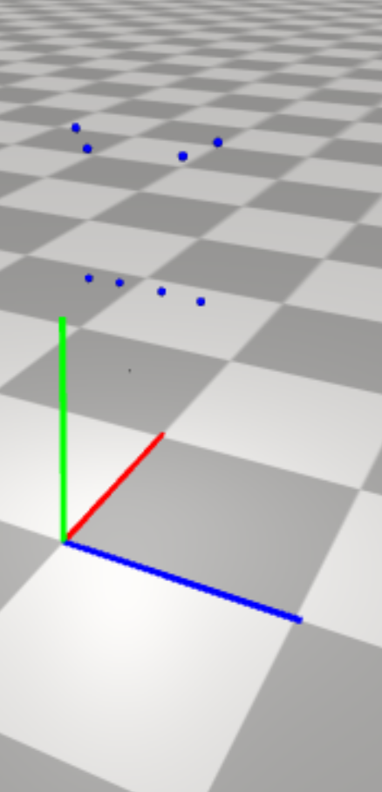
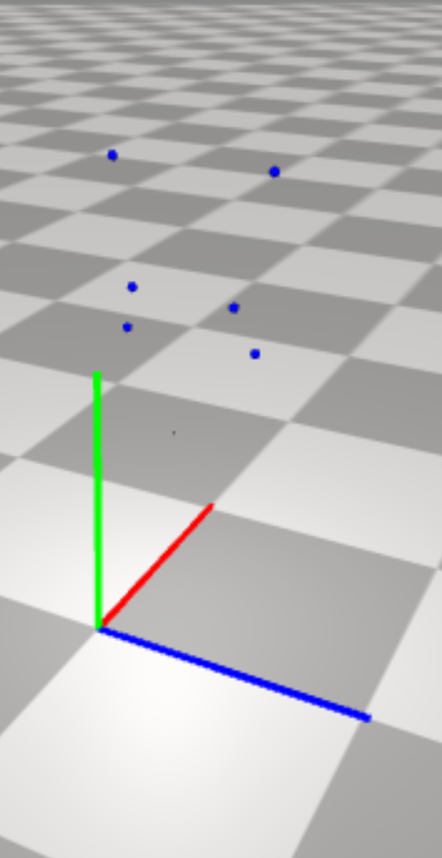
List of technical markers: Tibial
Global (Tibial)
fibular head
lateral malleolus
anterior shank 30
Anatomical (Tibial)
fibular head
tibial tuberosity
lateral malleolus
medial malleolus
Anatomical
Global

Slide 4
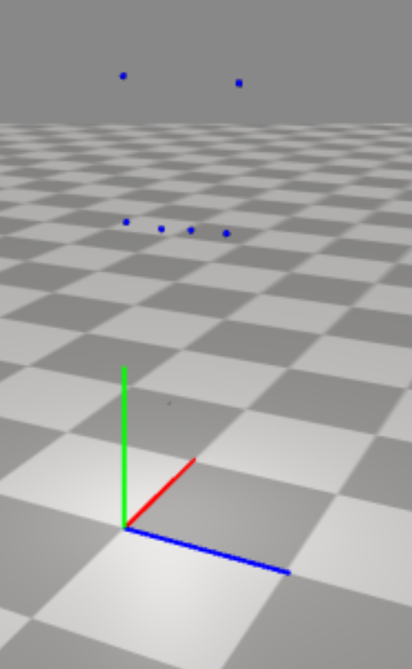
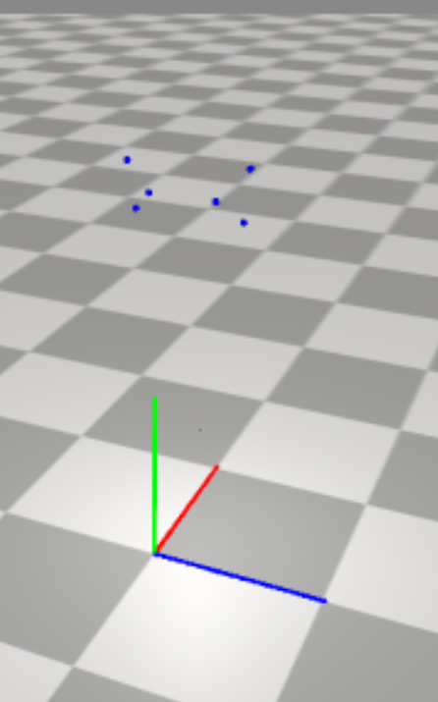
List of technical markers: Femoral
Global (Femoral)
lateral femoral epicondyle
anterior thigh 15
lateral thigh 25
Anatomical (Femoral)
lateral femoral epicondyle
medial femoral epicondyle
greater trochanter
Anatomical
Global

Slide 5
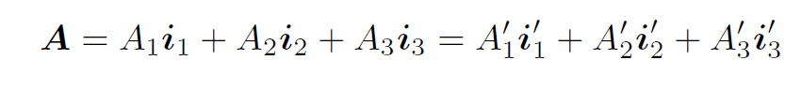
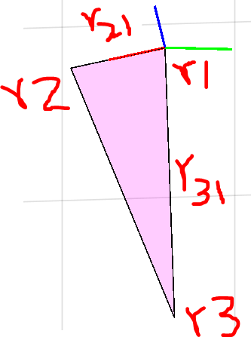
Construction of technical marker frame
Let the global position vectors of the three points be r1(t), r2(t), r3(t)
The collinearity of these points is determined using point cloud object operations
Origin = r1(t) = Translation vector
Let r_21(t) = r2(t) – r1(t) and r_31(t) = r3(t) – r1(t)
X-axis is along r_21(t)
Y-axis is along cross(r_21(t), r_31(t))
Z-axis is defined by the right-hand thumb rule and constructed using a cross product
Rotation vector is obtained through equation above on page and first principles (expressing Ax’ in terms of Ax… )

Slide 6
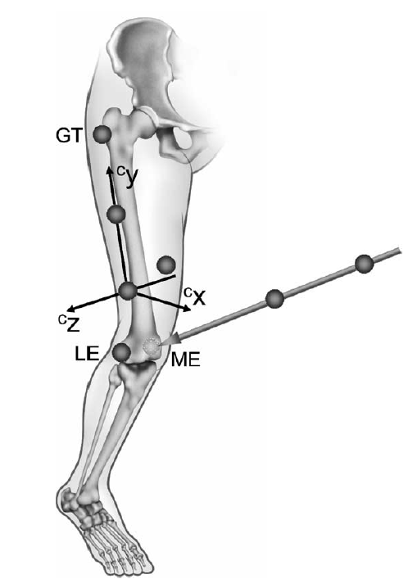
Anatomical calibration parameters extraction
Consider the static calibration trial for a given subject
The technical marker frame (c-frame in figure) can be constructed
The pose of the technical marker frame (T, R) can be obtained
The validity of R can be checked
Inverse [R] = Transpose [R]
Determinant [R] = +1
The global position vector of the anatomical markers can be converted to local position vectors in the technical marker frame using (T, R)
These “local position vectors” can be averaged over the duration of the trial to obtain the “ anatomical calibration parameters”

Slide 7
Ideas for validation and why?
Animation
Easy to check if the desired geometric relationship exists between the technical / anatomical frame and technical markers / body segment
If the triangular segment formed by the technical markers vaguely resembles the corresponding body segment
If the segment formed by the anatomical markers resembles the corresponding body segment more strongly than the technical markers
If the segments formed by the reconstructed and true positions of the anatomical markers are close to each other
Toy model to test out:
Local to global coordinate transformation
Pose estimation
Geometric relationship between technical frame and technical markers
Invalidate anatomical calibration if representative error between the reconstructed and true anatomical marker position is greater than a tolerance

Slide 8
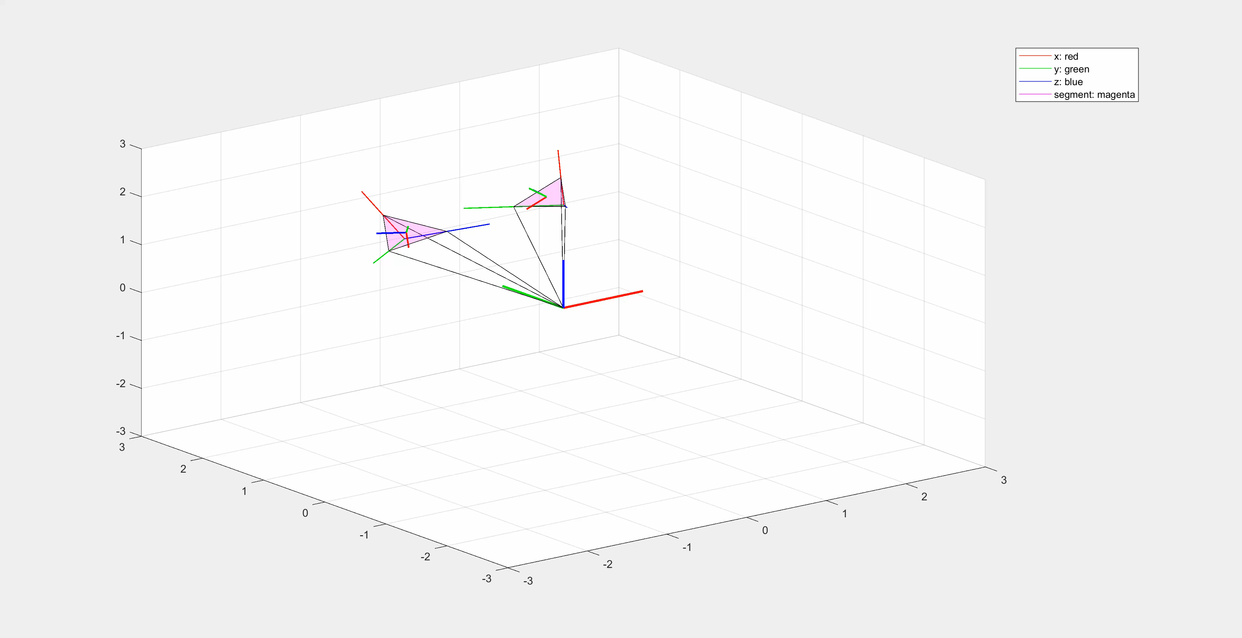
Toy model: Linear

Slide 9
Toy model: Sine

Slide 10
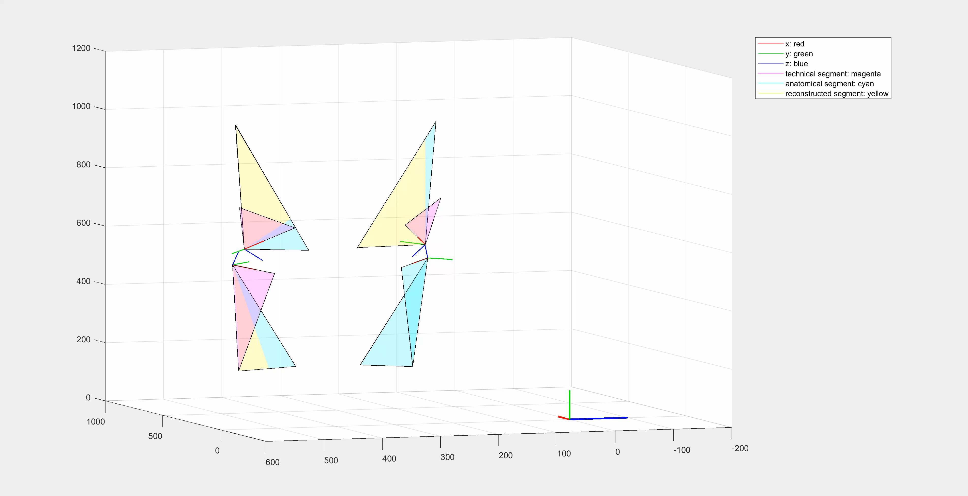
Validation of the process so far…

Slide 11
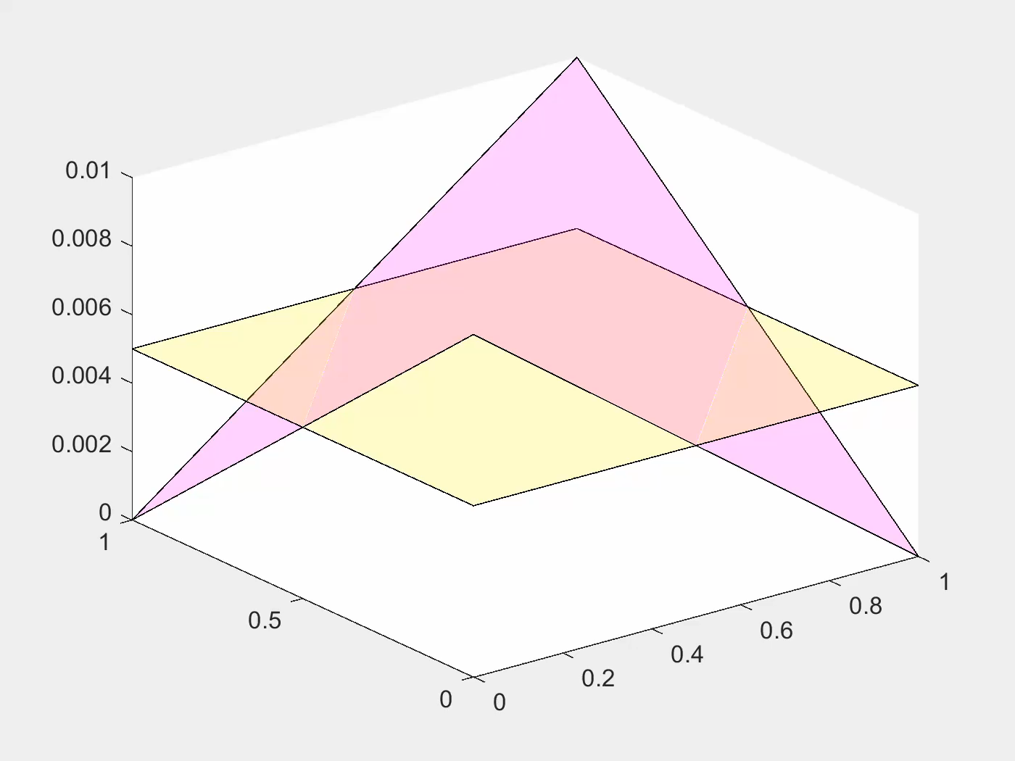
Toy model: Oscillating Triangle (close)

Slide 12
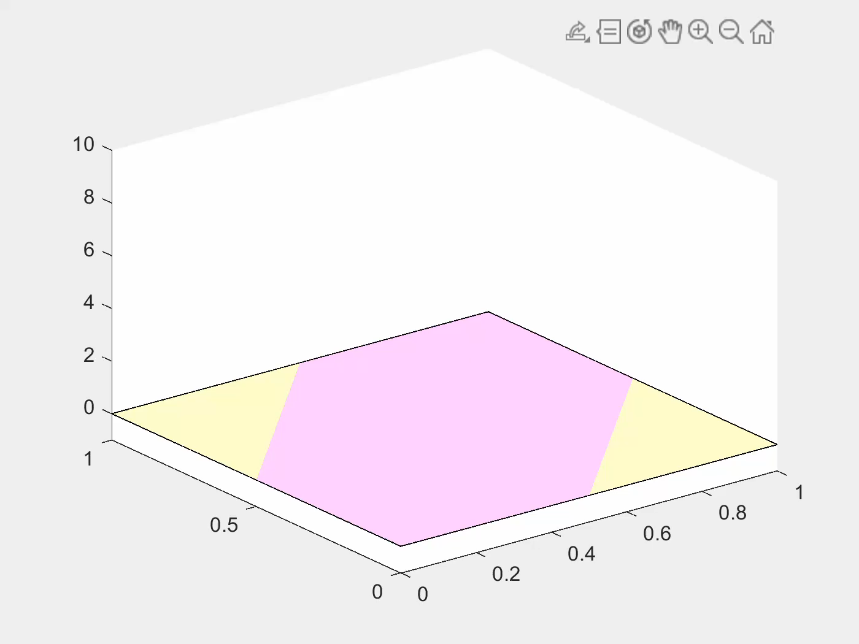
Toy model: Oscillating Triangle (far)

Slide 13
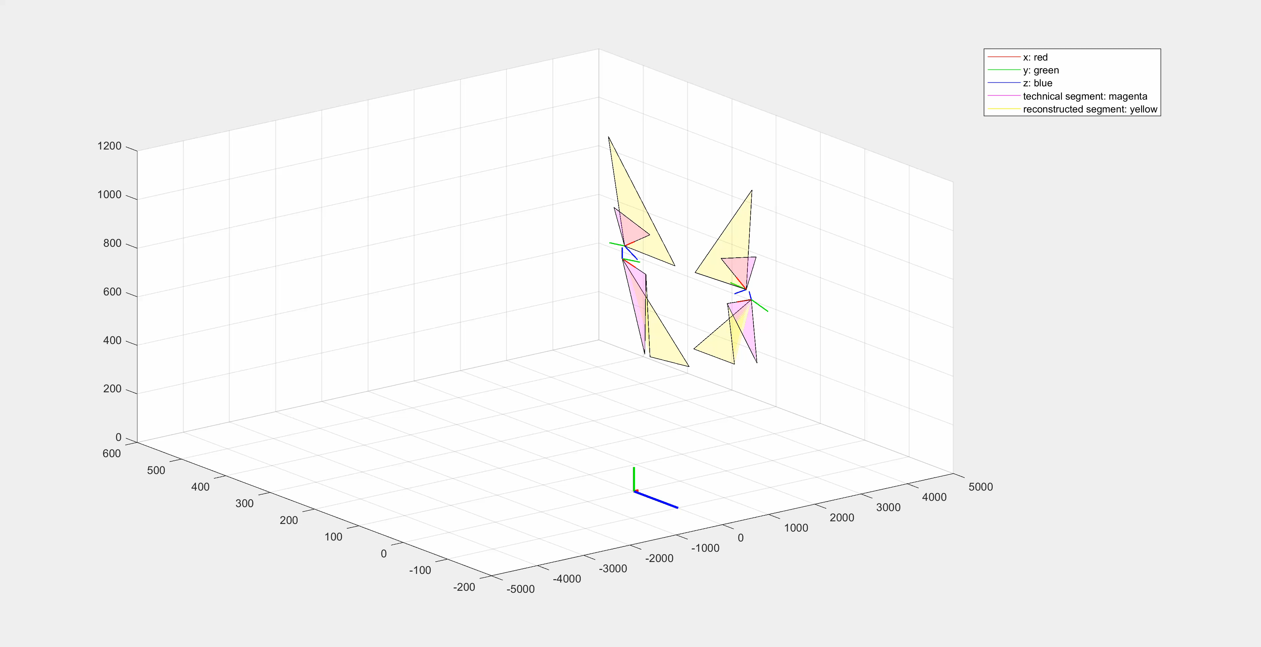
Walking example

Slide 14
Challenges during animation
Optical motion capture and MATLAB have different inherent global reference frames
The perspective (view vector) needs to be adjusted well so that the visualization makes sense
The scales of the plot need to be adjusted appropriately for the visualization to make sense
Issues with memory exist for large videos and ffmpeg toolbox may need to be deployed
Computer hangs every time MATLAB saves a video file

Slide 15
Next steps
Implement construction of anatomical frames and obtain Euler angles for the knee
Validate the implementation first for the static calibration trial
Validate the implementation for remaining activities. Start with walking! (amongst the various activity data present, seems to be simpler than the rest and is widely studied. Therefore, it will be considered first.
Hopefully, the animation, knee-angle plots and any code crashes will give us a clue as to the most natural next step, which may be:
Smooth / Interpolate based on Visual3D documentation
Rigid Body pose estimator (Triangle method)
Point cluster technique (Soft tissue artifact)
Use Femoral Head (FH) instead of Greater Trochanter (GT) marker for femoral anatomical frame

